Slide 1

Beavers Campus Event Ticketing & Revenue System
Empowering student organizations with a seamless platform for event management, ticket sales, and financial intelligence.
Presented by: Sri Subramanian, Sanskriti Khadka, Maaz Qasim, Mahir Shahriar, Avirup Ray, Ibsan Hossain

Slide 2

What, Who, and Why?
What We're Building
Who Needs It
A centralized platform enabling student organizations to create, manage, and promote campus events with integrated ticket sales, attendance tracking, and automated financial reporting, all in one place.
Student Organizations: Simple ticket sales without cash handling or complex third-party systems
University Departments: Oversight and support for student-led events
Students: One reliable platform to discover and purchase all campus event tickets
Why Investors Care
This platform captures rich behavioral data on student engagement, event popularity, and spending patterns: invaluable intelligence for university planning and businesses targeting the student demographic.

Slide 3
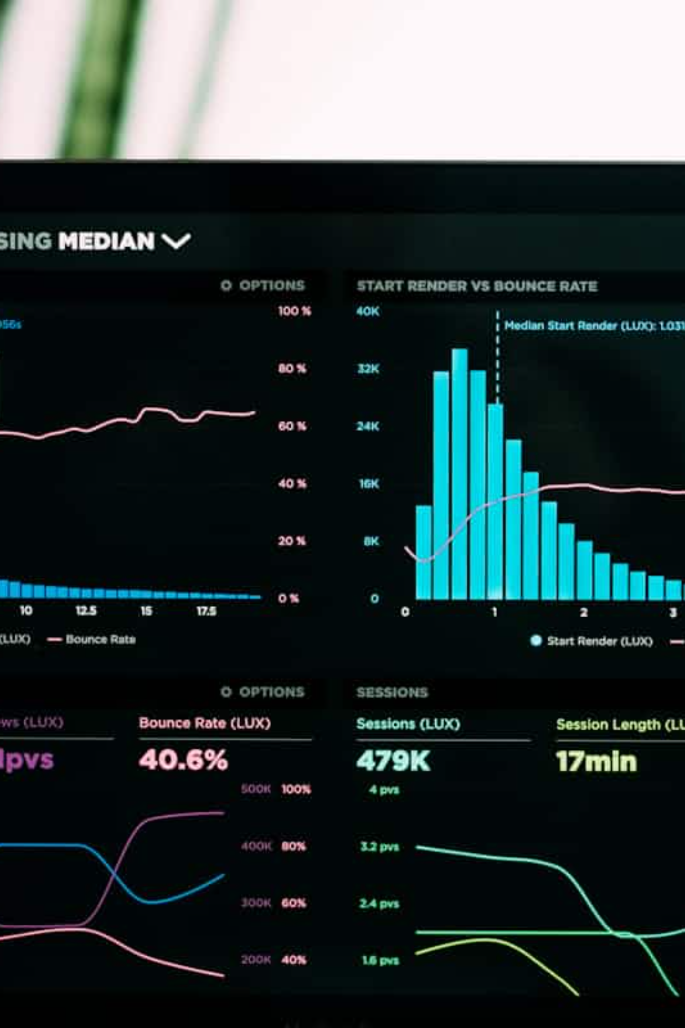
Revenue Model
Service Fee
A percentage or flat fee on each ticket sold through the platform (our primary revenue driver).
Data Insights
Anonymized, aggregated event and attendance data packaged for universities and local businesses seeking student market intelligence.

Slide 4
User Stories
Organization Leader
Student Buyer
01
01
Login and navigate to Create Event
Browse central campus event calendar
02
02
Enter event details: name, date, location, description
Filter by organization, date, or event type
03
03
Set ticket pricing, quantity, and sales window
Select event and choose ticket quantity
04
04
Publish event live to the platform
Complete secure checkout
05
05
Monitor real-time sales data and attendance
Receive QR-coded digital ticket via email and app

Slide 5
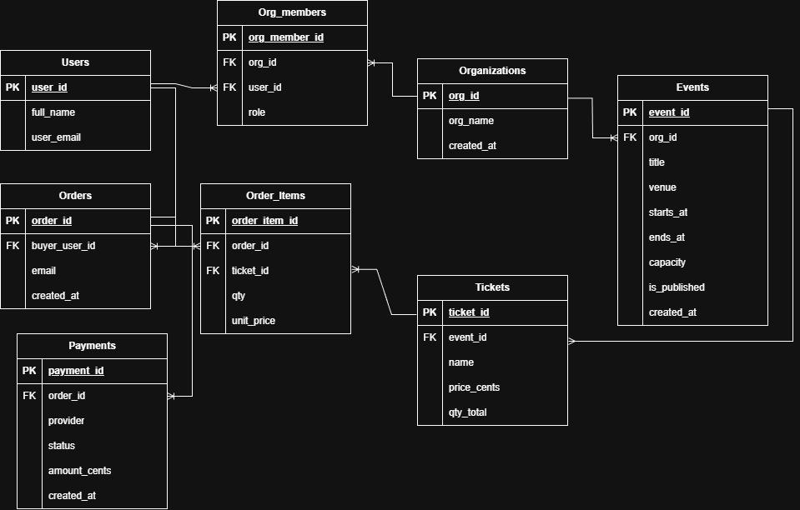
Data Model

Slide 6



Technology Stack
Frontend
Backend
Database
React with HTML, CSS & JavaScript for responsive, fast web and mobile experiences
Python Flask framework handling business logic, API routes, and data processing
MySQL providing reliable, structured data storage with ACID compliance
Deployment
Reporting
Docker containerization enabling consistent, scalable production deployment
One-click Excel export for attendance and revenue analytics

Slide 7
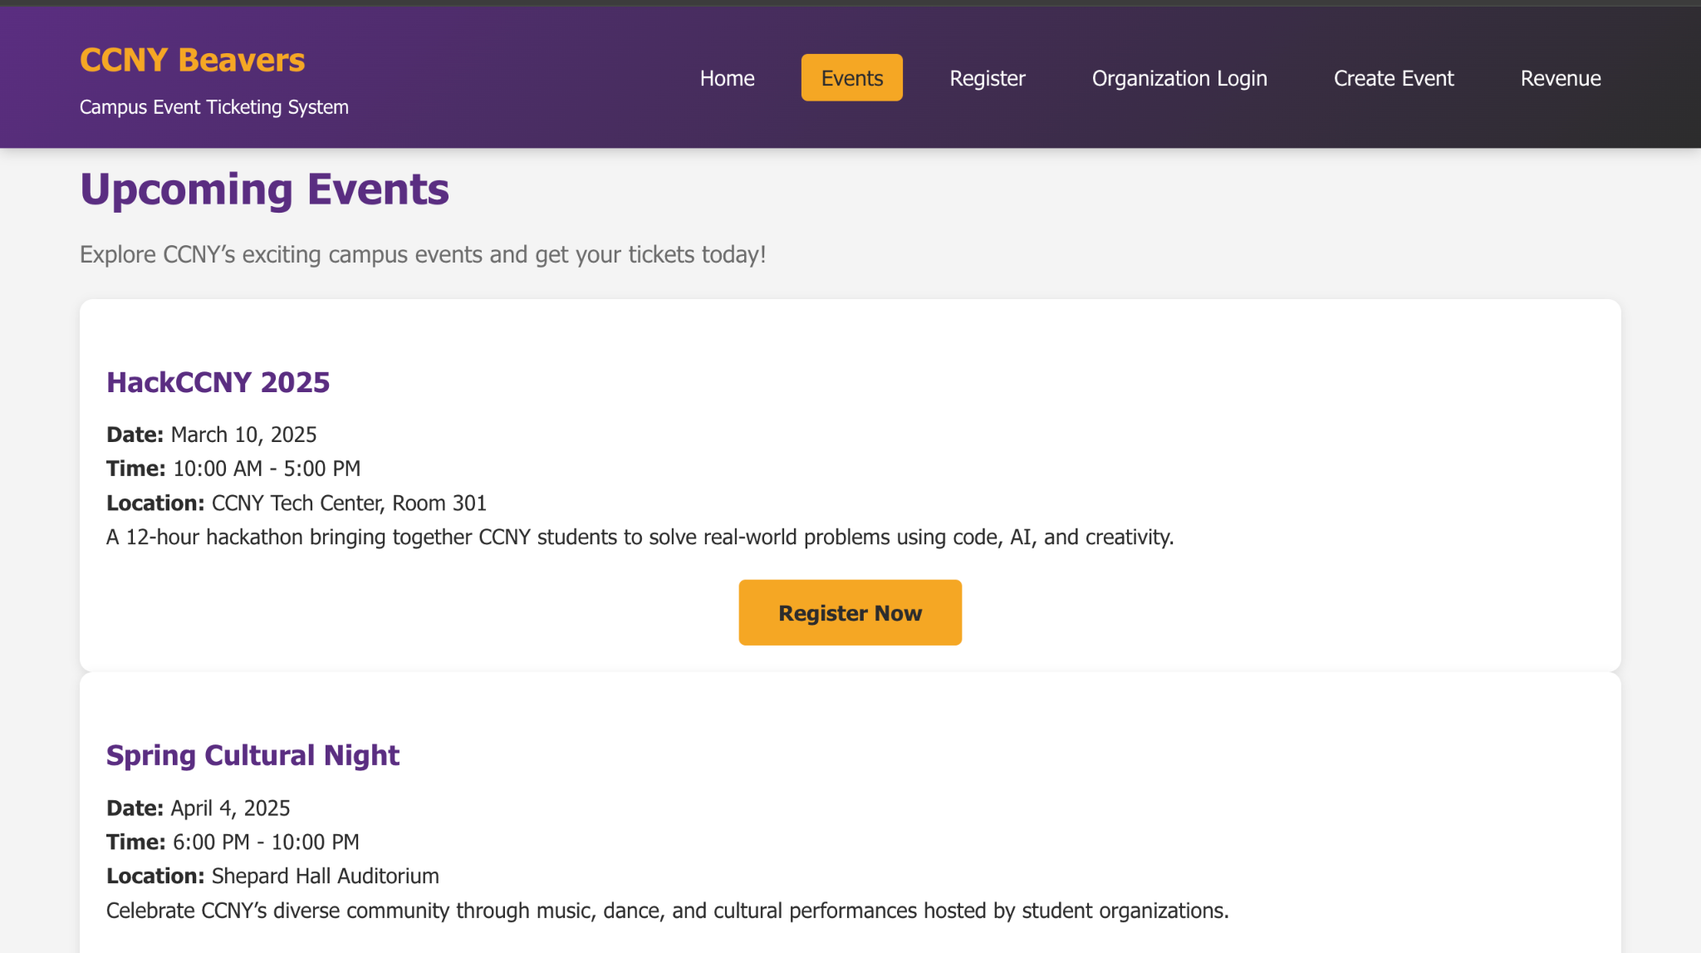
Prototype

Slide 8
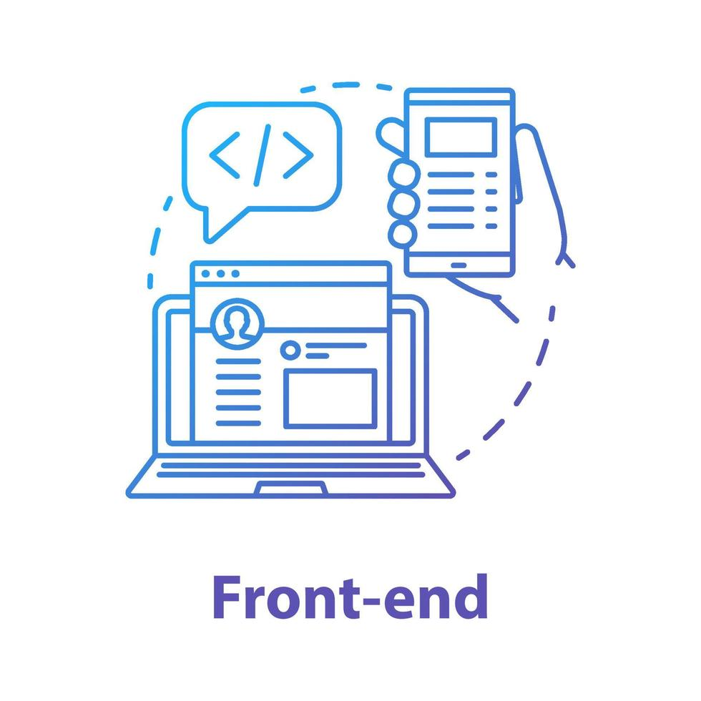


Our Team
Front End
Back End
Database
Avirup Ray
Ibsan Hossain
Maaz Qasim
Mahir Shahriar
Sanskriti Khadka
Sri Subramanian

Slide 9

Questions?

